Slide 1
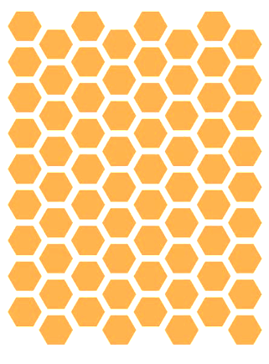
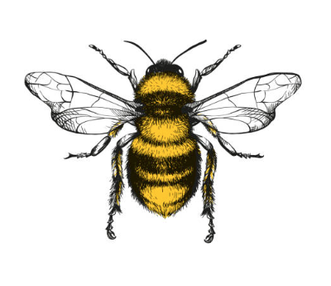
Bee Colonies: What’s the Recent Buzz?
zzzz
zzz
By: Michelle Bui
NYC Data Science Academy

Slide 2
History of Honey Bee Losses
A timeline of the landslide in colony losses
Over 50% reduction in number of colonies in the U.S. from the 1940’s
1947
1987
2021
1940’s
Introduction of DDT & other harmful pesticides
Introduction of Invasive Varroa Mites + other pathogens
2.8 million
6 million
1970
# of Small Farms After WW2
Habitat Loss & Global Warming
3 million
Notes:
Dipping to a low of ~ 2.3 million in 2006 before making some recovery
Sources:
https://www.ars.usda.gov/oc/br/ccd/index/#history
https://www.intechopen.com/chapters/50073

Slide 3
A Mystery Plague: Colony Collapse Disorder (CCD)
First characterized in 2006, beekeepers reported as much as 30-90% loss of their hives
Signs of CCD:
Sudden vanishing/loss of a colony’s worker bee population
Little to no dead bees
Queen and young brood remain
Abundant honey and pollen reserves remain
Without worker bees, the hives eventually die off
Despite intense research, no definitive underlying cause has been identified for CCD
Suspected causes:
Parasites
Diseases
Pesticides
Loss of habitat
Poor nutrition
Notes:
Source:
https://www.epa.gov/pollinator-protection/colony-collapse-disorder#:~:text=Pesticide%20poisoning%20through%20exposure%20to,the%20habitat%20where%20bees%20forage.

Slide 4

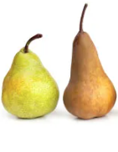

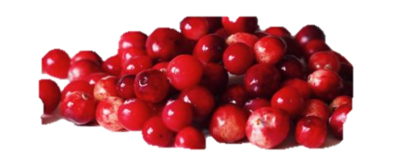
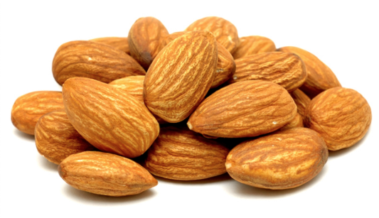
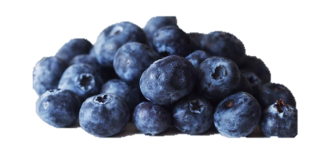
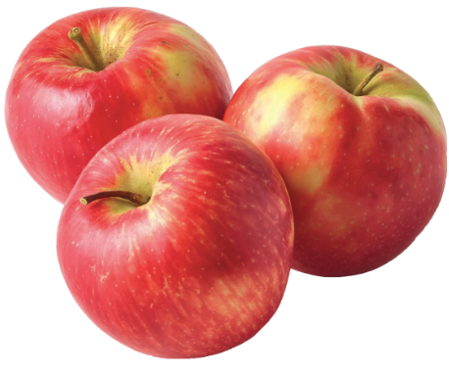
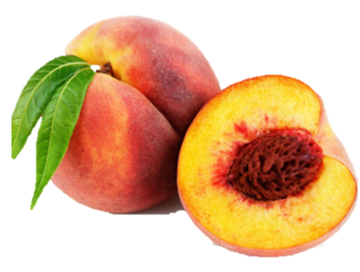
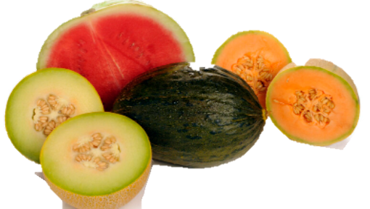
Save The Bees!
The bee die off has been termed the Bee-pocalypse or Beemageddon
Bee colony loss poses a threat to food security
Bee pollination enables the production of 90+ commercially grown crops in North America
Their combined services of bees in the U.S. alone are worth greater than
15 billion dollars
Image Source: https://shorebags.com/blogs/news/were-honoring-the-disappearing-honey-bee
Notes:
Source: https://www.washingtonpost.com/news/wonk/wp/2015/07/23/call-off-the-bee-pocalypse-u-s-honeybee-colonies-hit-a-20-year-high/
Alfalfa
Almonds
Apples
Asparagus
Beans
Beets
Blackberries
Blueberries
Brussels sprouts
Buckwheat
Cabbage
Cantaloupe
Cauliflower
Celery
Cherries
Chestnuts
Chives
Clover
Cranberries
Cucumber
Currants
Eggplant
Flax
Garlic
Gooseberries
Grapes
Horseradish
Kale
Lettuce
Mustard
Onions
Parsley
Peaches
Pears
Plums
Pumpkins
Radishes
Raspberries
Rhubarb
Squash
Strawberries
Sunflowers
Sweet potatoes
Turnip
Watermelon

Slide 5
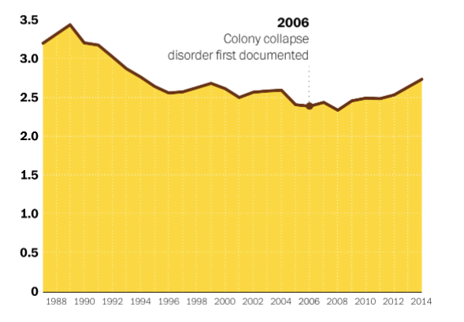
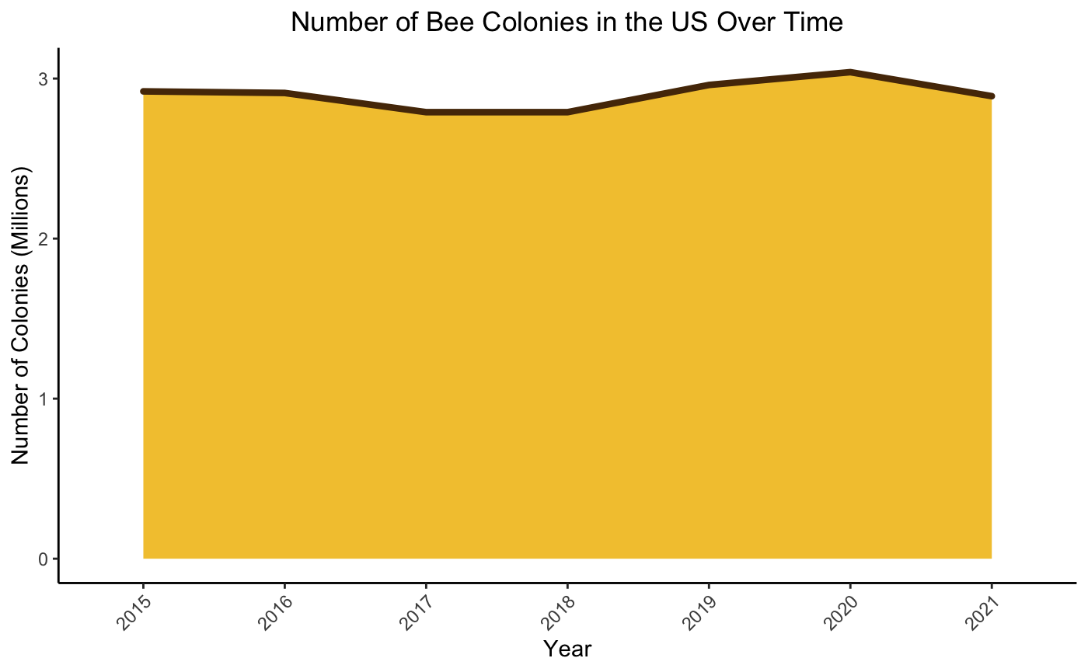
How Have Bees Been Doing Recently?
Thankfully, bee colony numbers are recovering from lowest record of 2.3 million in 2008
Colony Collapse Disorder (CCD) first characterized
2006
Stable populations in recent years
Source: USDA Honey Production Surveys

Slide 6
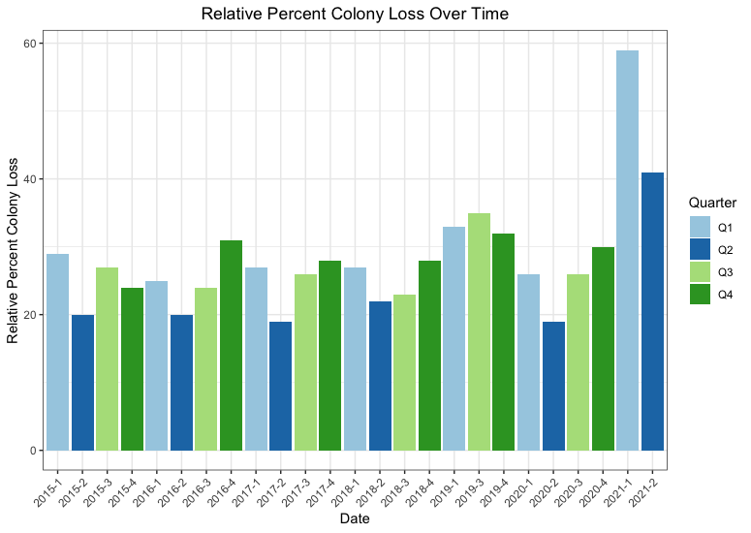
Colony Loss Across the U.S. in Recent Years
Notes:
https://cmr.berkeley.edu/2016/10/colony-collapse-disorder/

Slide 7
Colony Loss Across the US Appears to Have a Cyclical Nature
Greater number of colony losses observed in the colder months (Q4 & Q1)
This makes sense as bees don’t migrate during the winter
Overcoming cold winter temperatures is crucial to colony survival and health
Colony loss is consistently lowest in the spring months (Q2) when nectar and pollen are most readily available

Slide 8
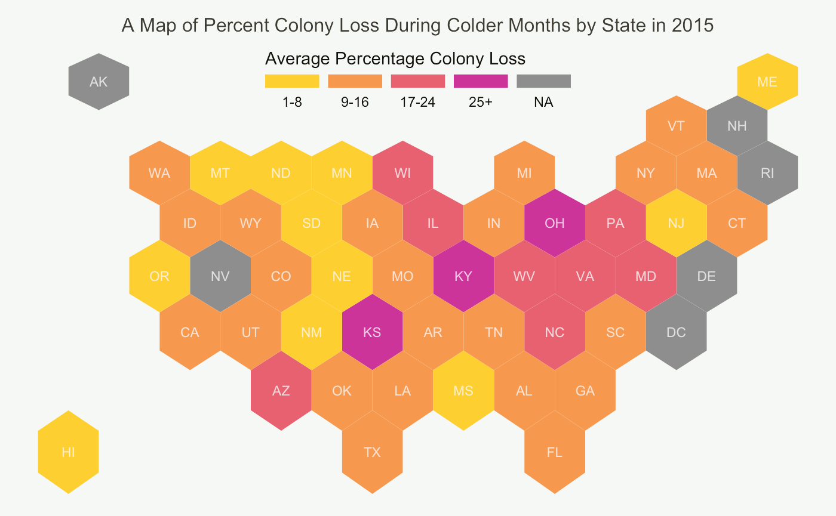
Are Bees Dying In Every State?
Notes:
- Losses mostly concentrated in the Midwest & South

Slide 9
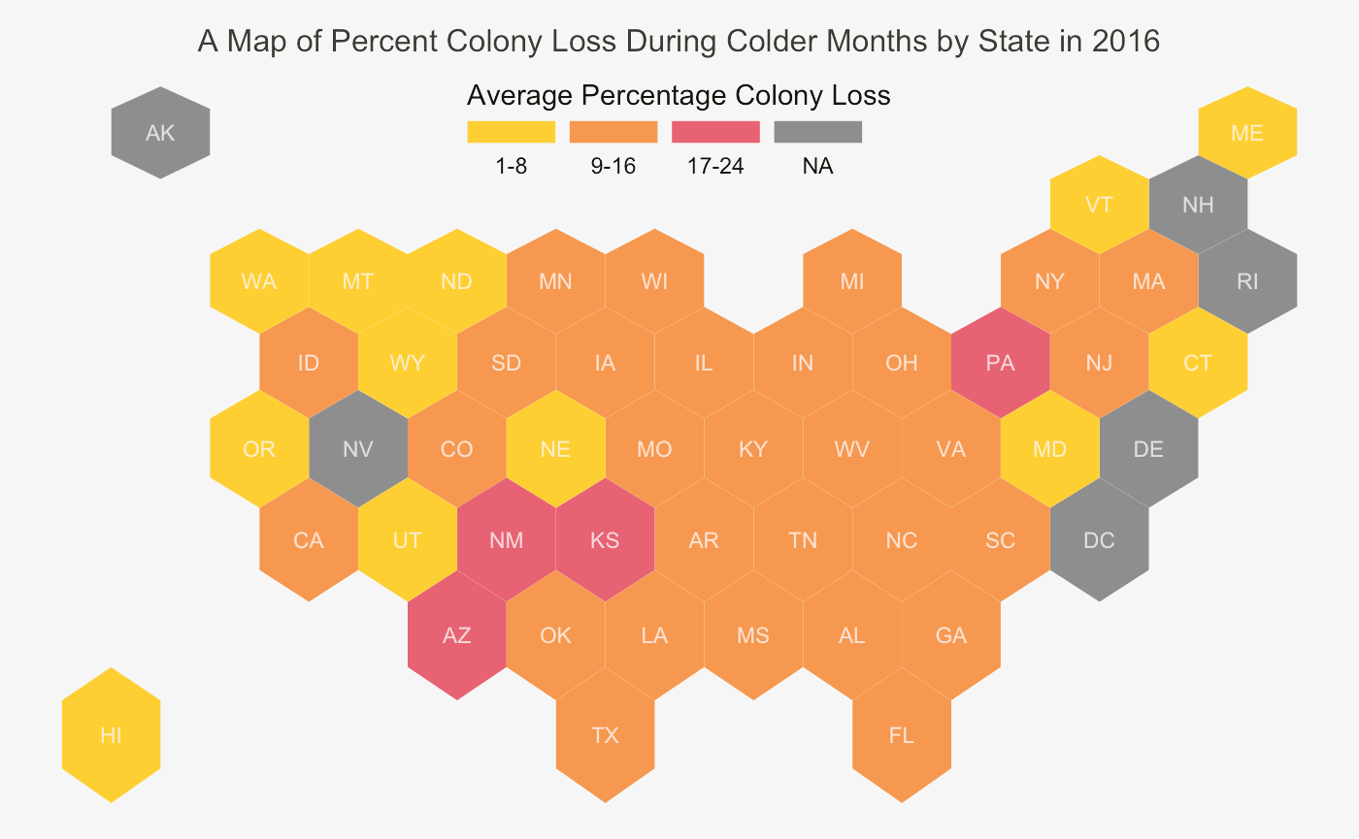
Notes:
- Greater losses in the southwest (new Mexico, Kansas, Arizona) and mid-Atlantic area (Pennsylvania)

Slide 10
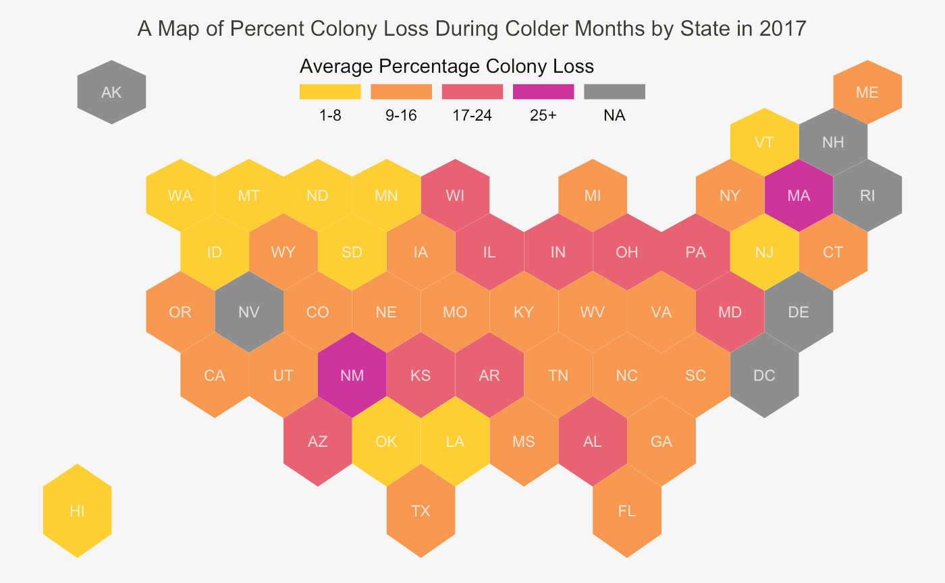
Notes:
- Most losses concentrated in the Midwest, as well as southwest, midatlantic

Slide 11
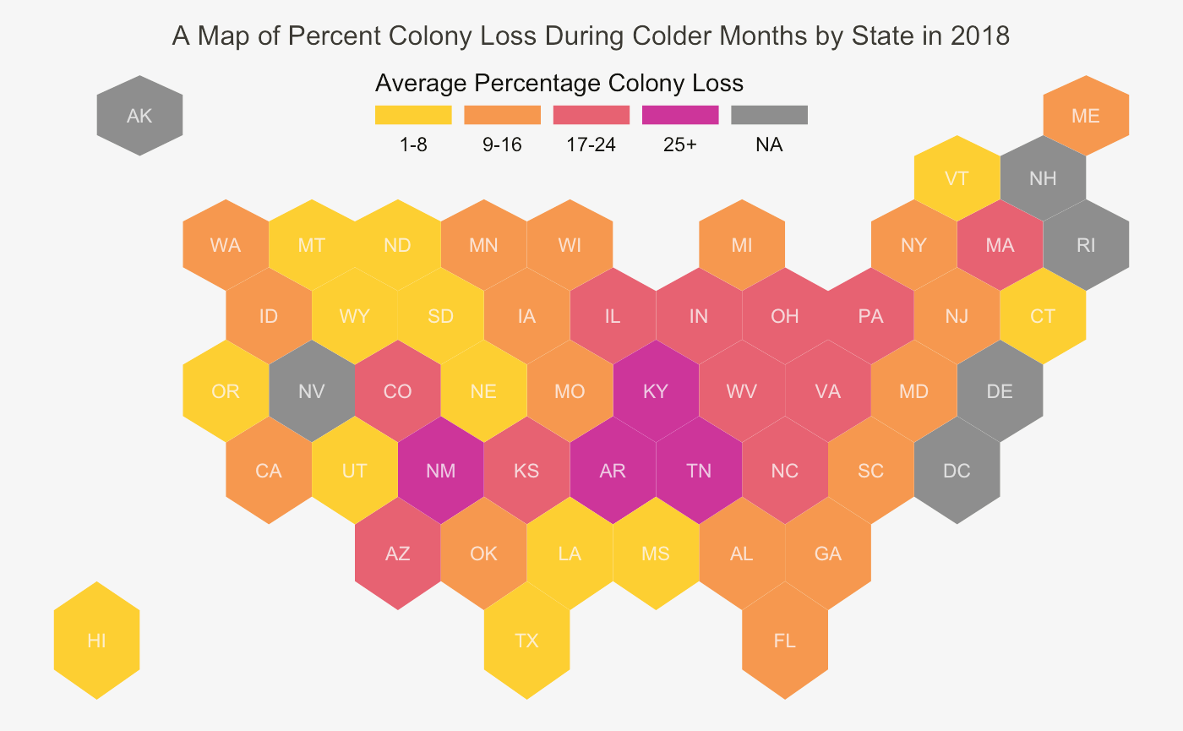
Notes:
- Most concentrated loss in the south, Midwest

Slide 12
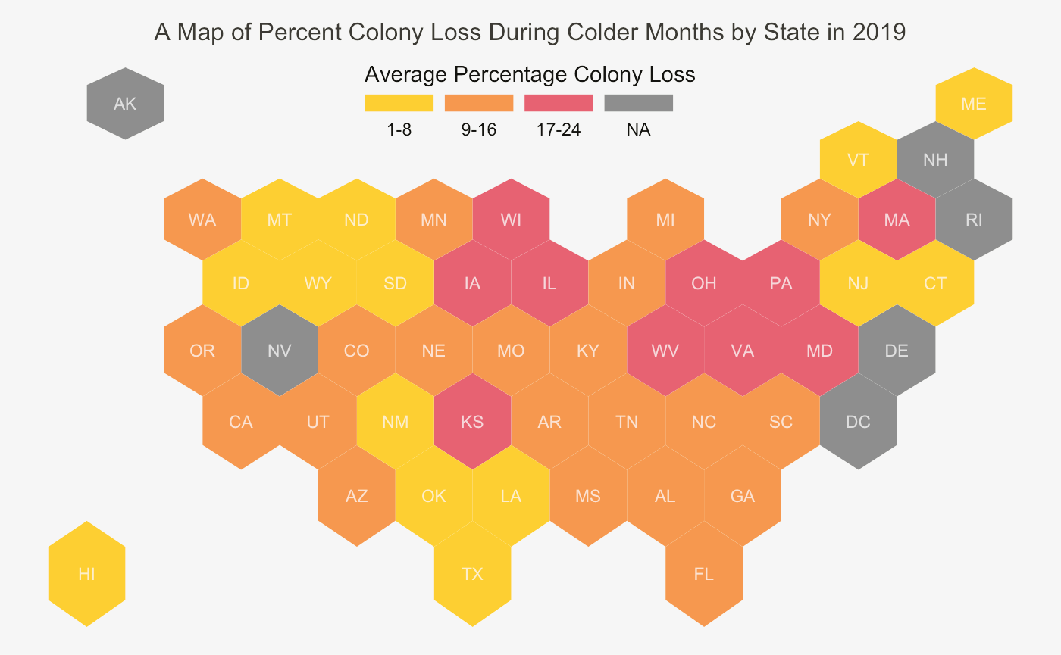
Notes:
- Most concentrated in Midwest and mid Atlantic

Slide 13
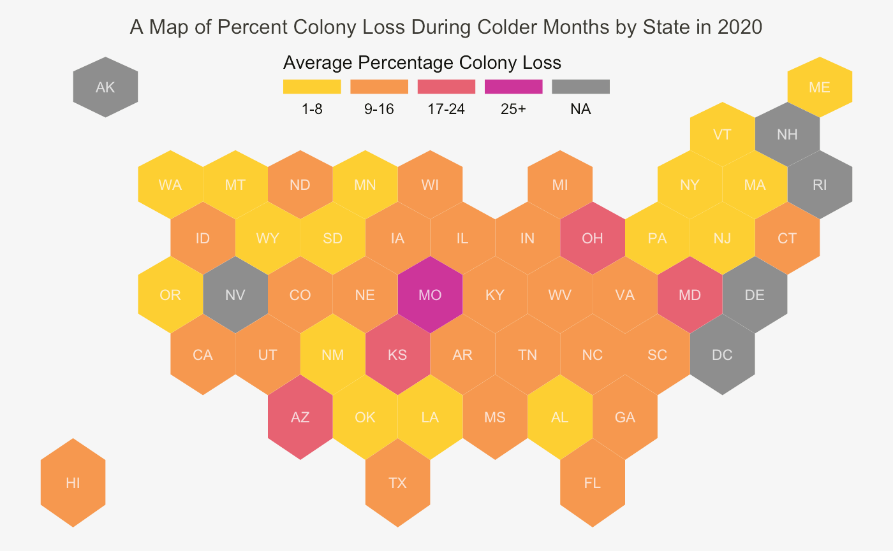
Notes:
- Most concentrated in Midwest

Slide 14
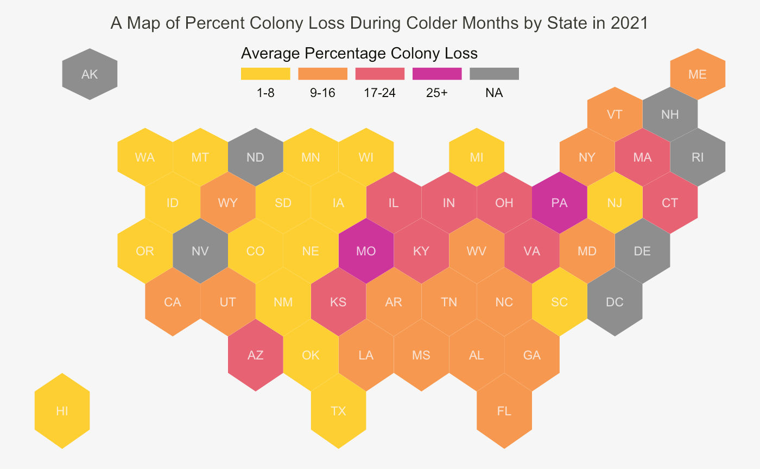
Notes:
- Midwest and mid Atlantic

Slide 15
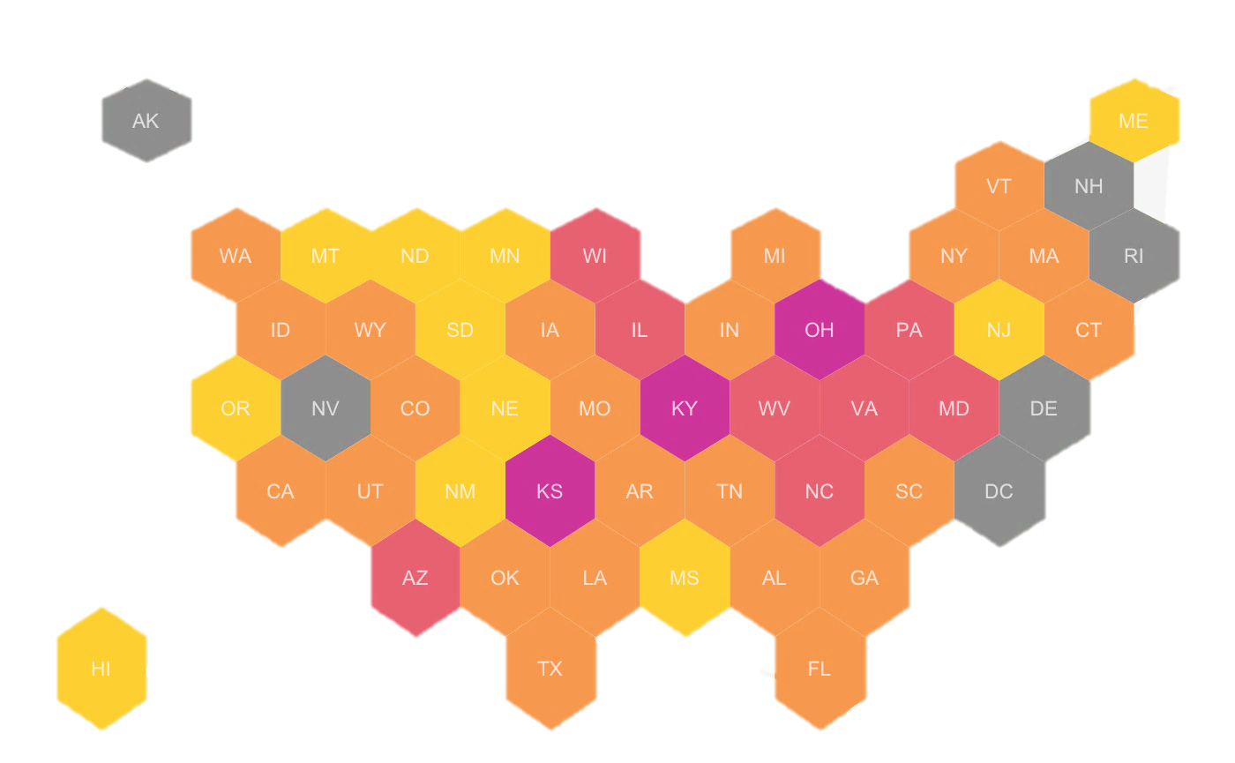
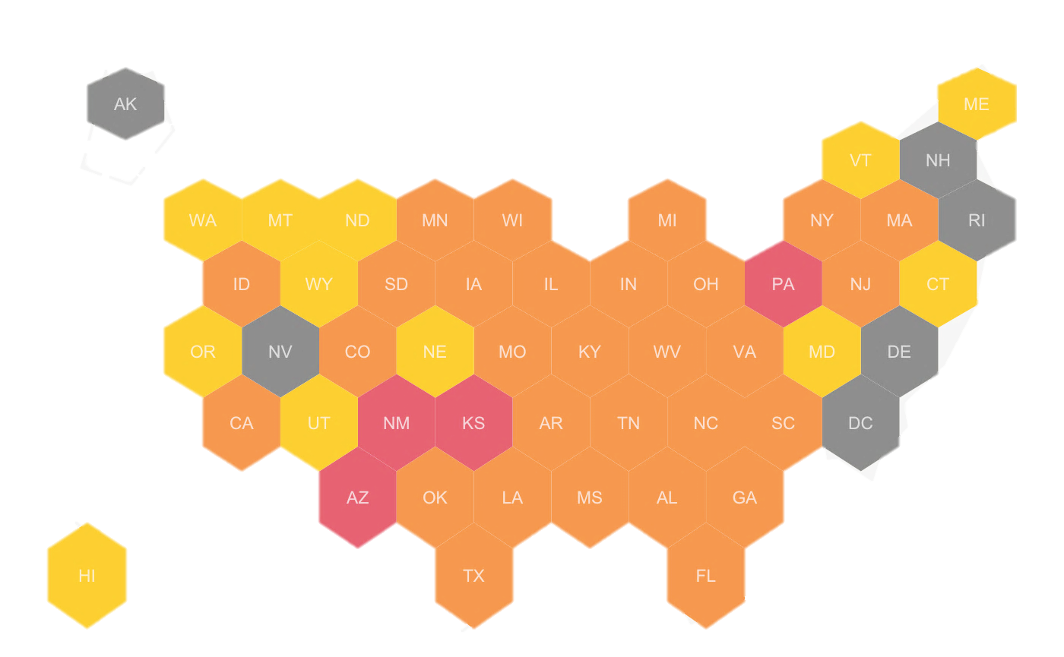
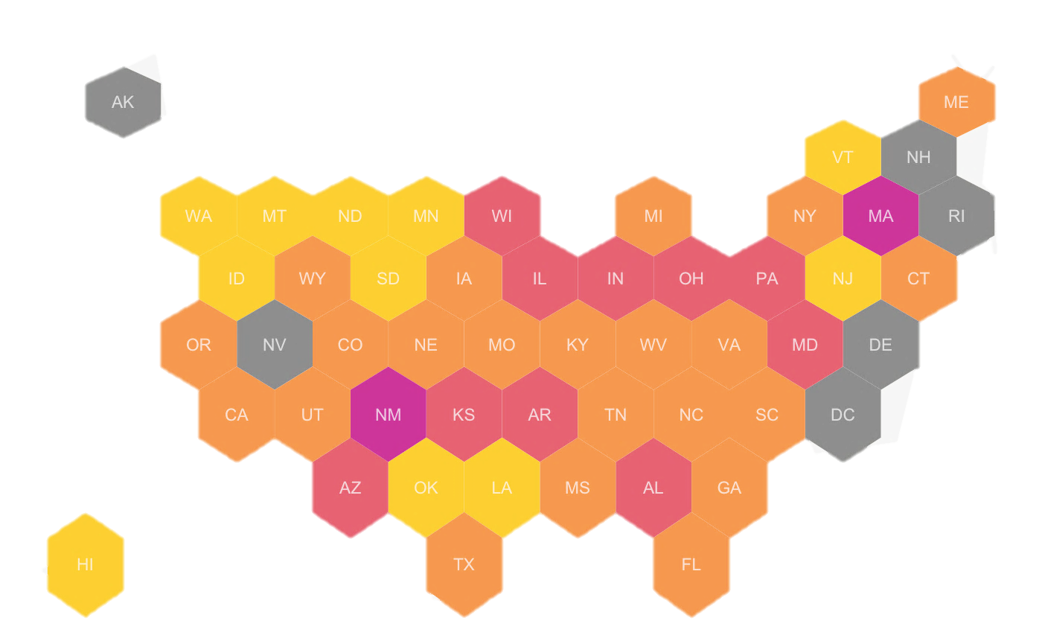
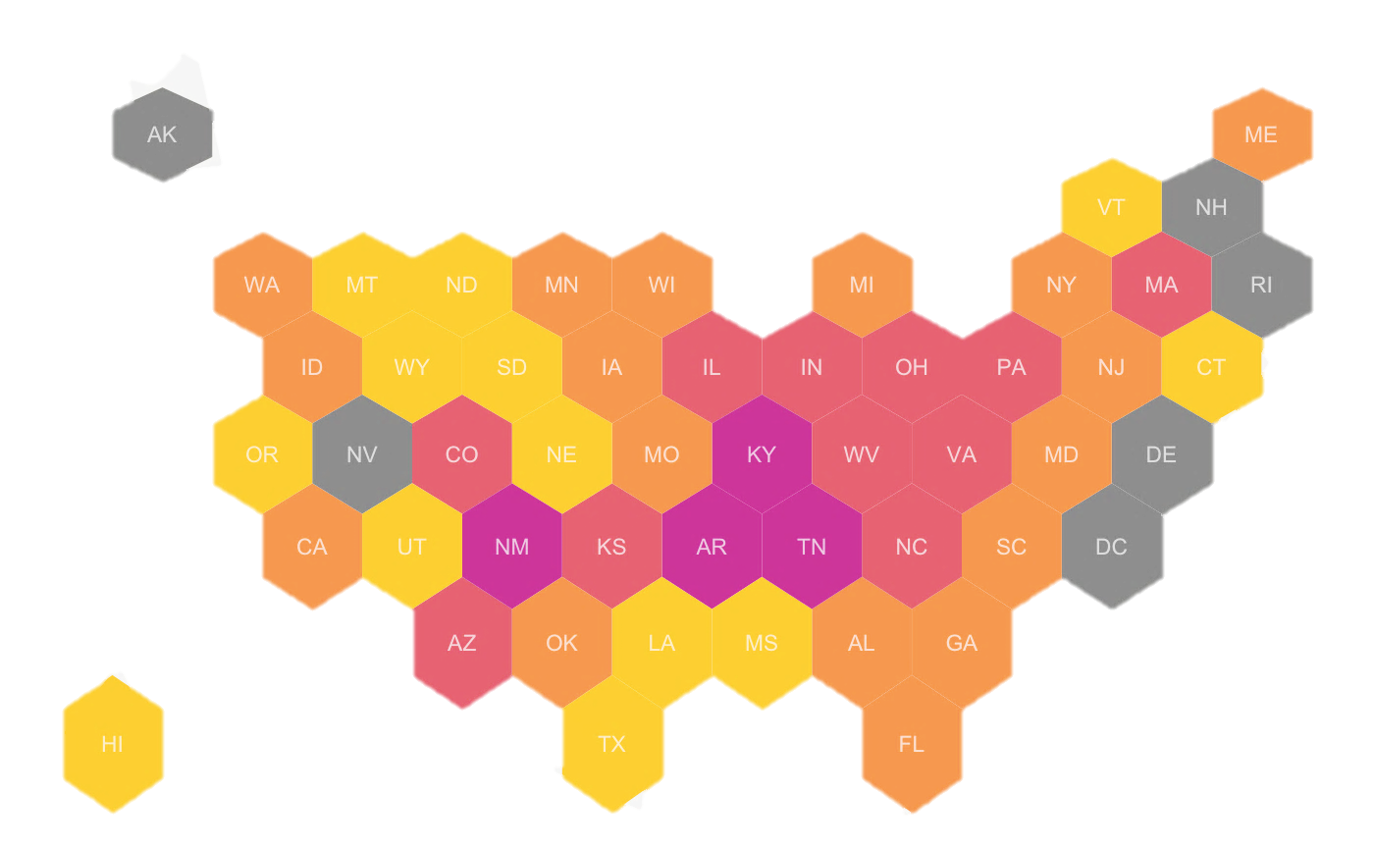
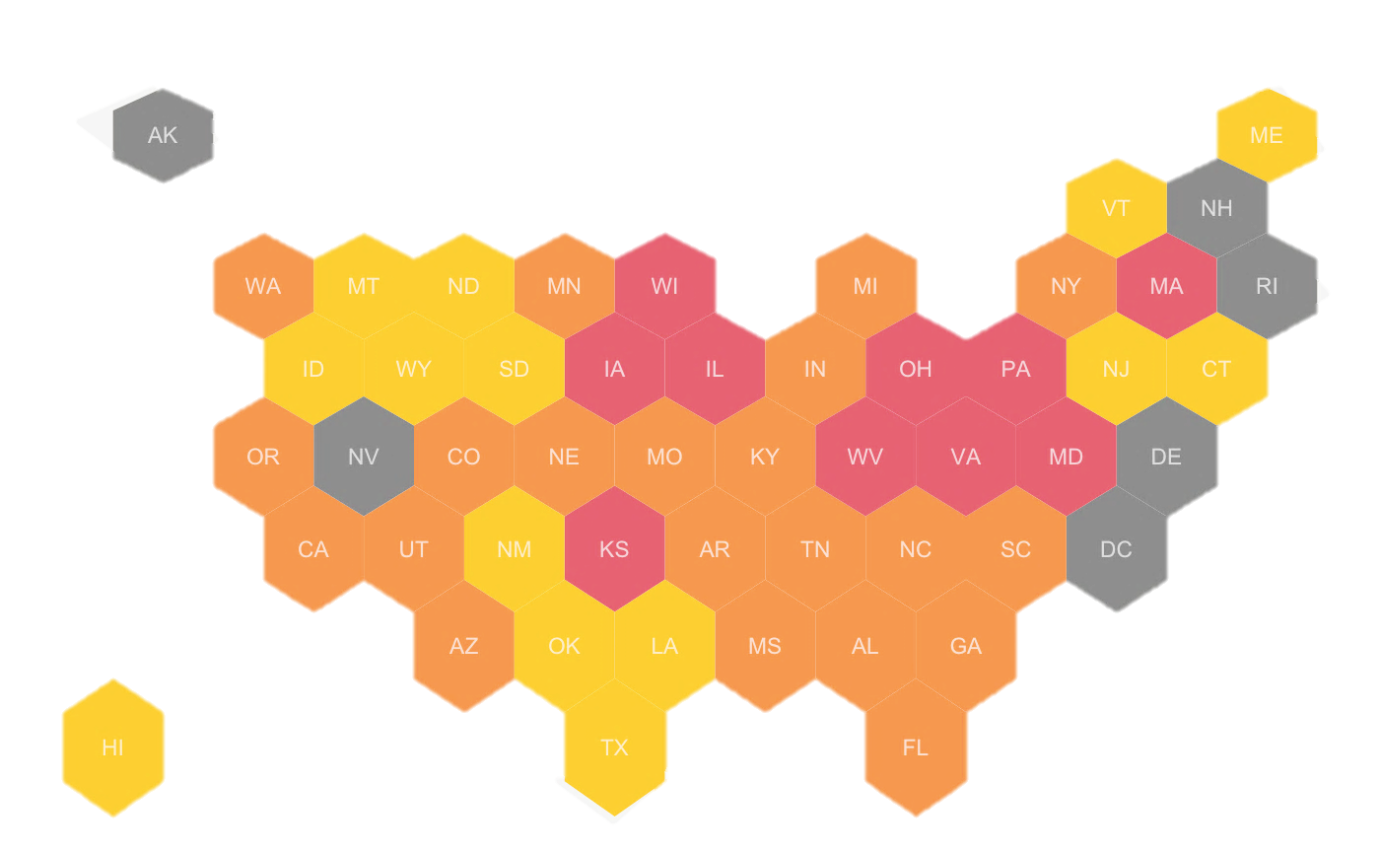
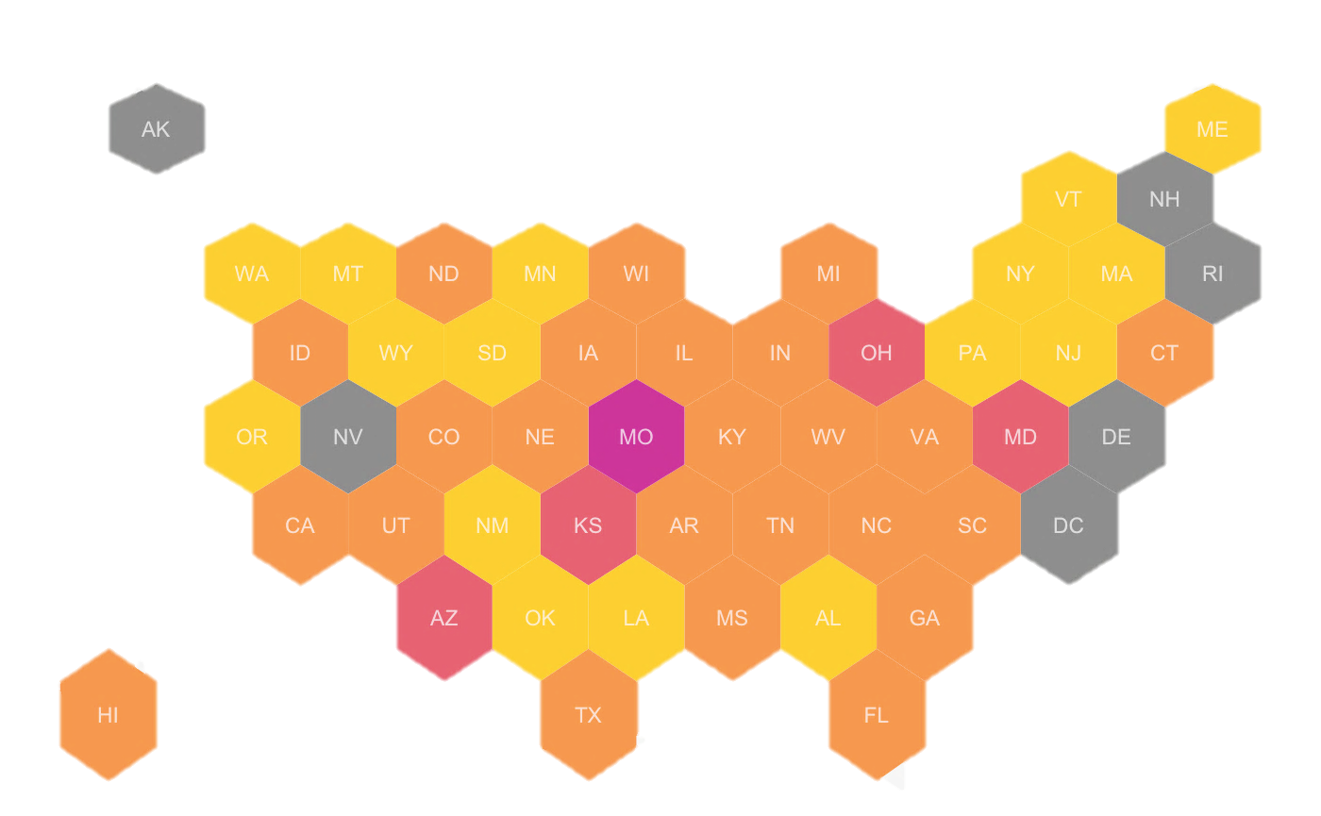
Percentage of Colonies Lost in Colder Months by State
2015
2016
2017
2018
2019
2020
2016, 2020 winters were not as bad for bee loss
2015, 2018 winters were much more fatal for bees
Mid-West and Mid-Atlantic regions experience the worst losses

Slide 16
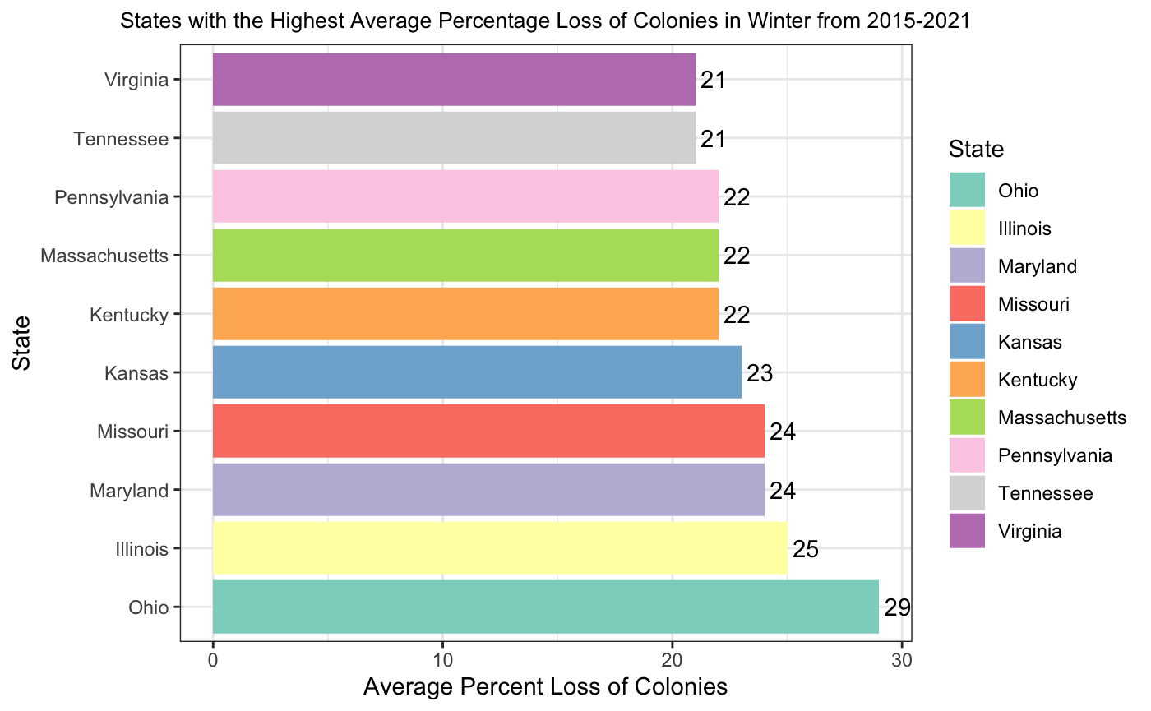
States with the Highest Average Winter Percent Losses

Slide 17
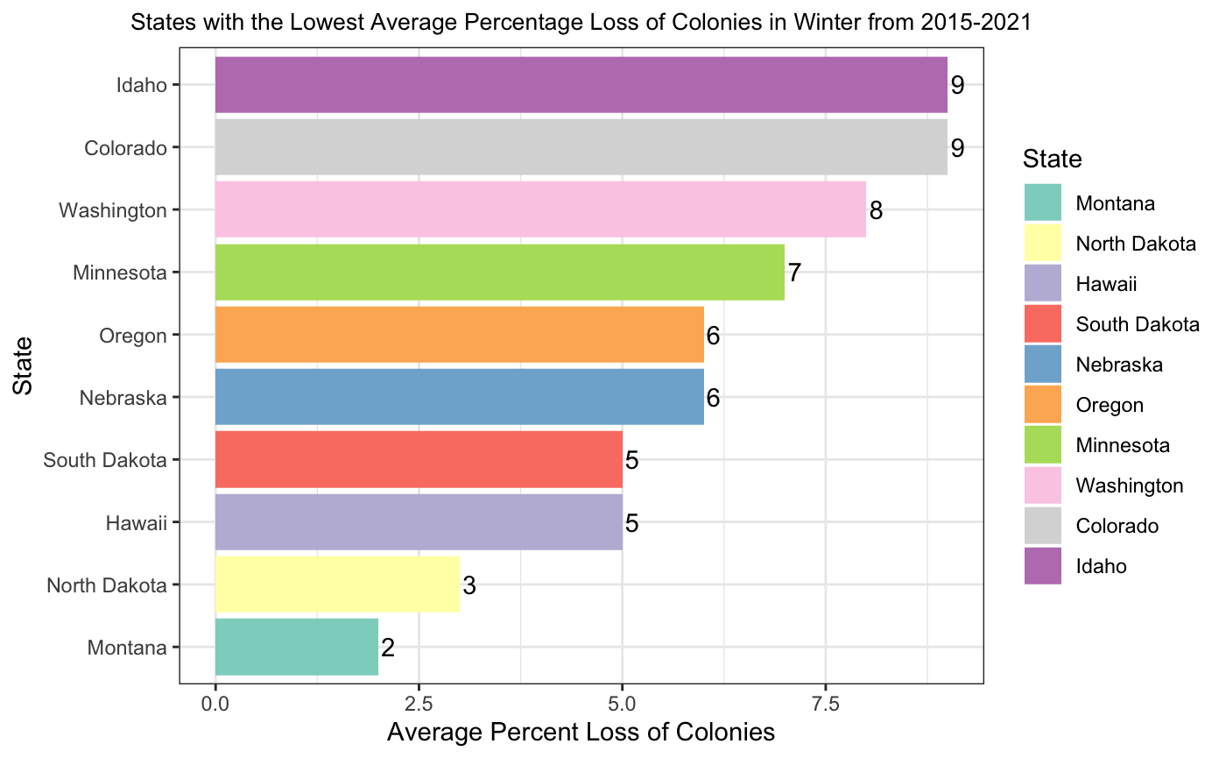
States with the Lowest Average Winter Percent Losses

Slide 18
Colony Loss Across the U.S. in Recent Years
Notes:
https://cmr.berkeley.edu/2016/10/colony-collapse-disorder/

Slide 19
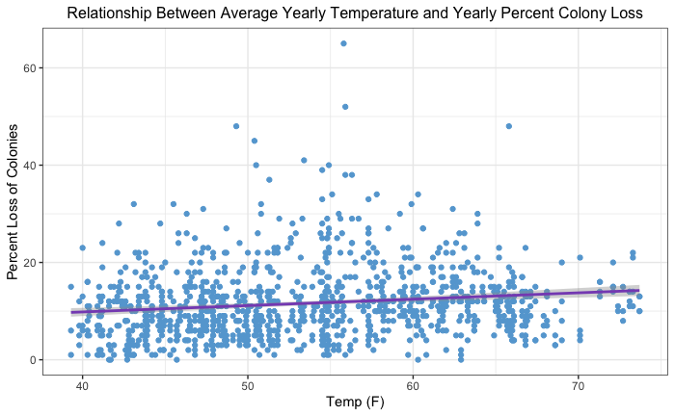
How are Temperature and Colony Loss Correlated?
Temperature is significant, indicating changes in temperature are correlated with changes in colony loss
Temperature is not explaining much of the variation in Colony Loss
Perhaps temperature data too broad or there are other factors
at play

Slide 20
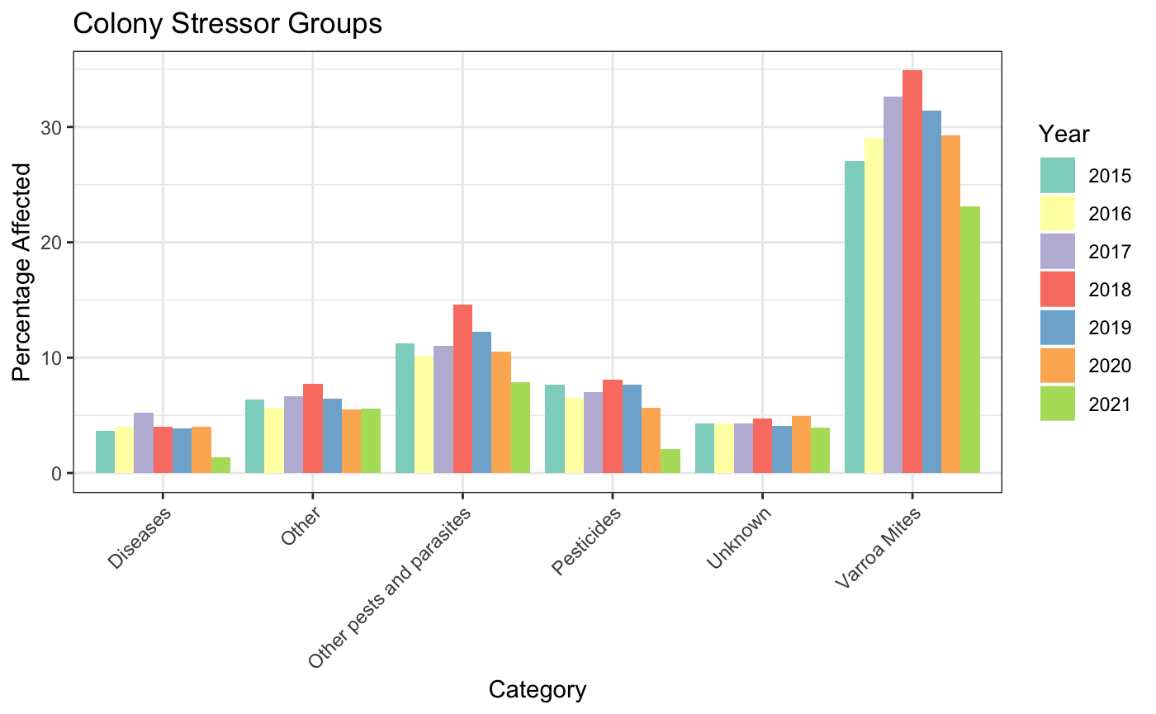
Examining Bee Colony Stressors
Of these stressors, Varroa Mites are the most prevalent, pervasive stressor across all years

Slide 21
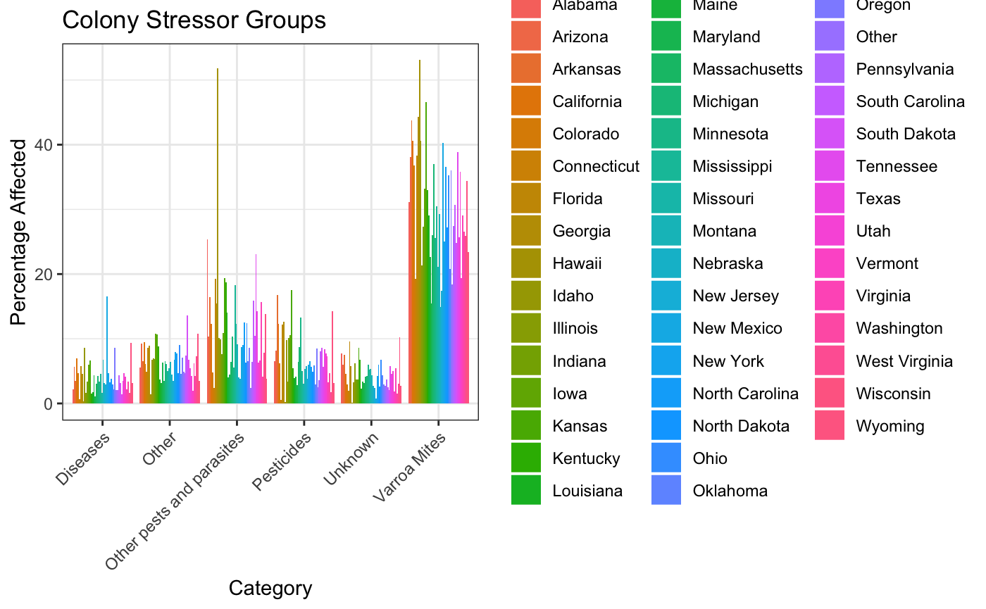
Bee Colony Stressors by State

Slide 22
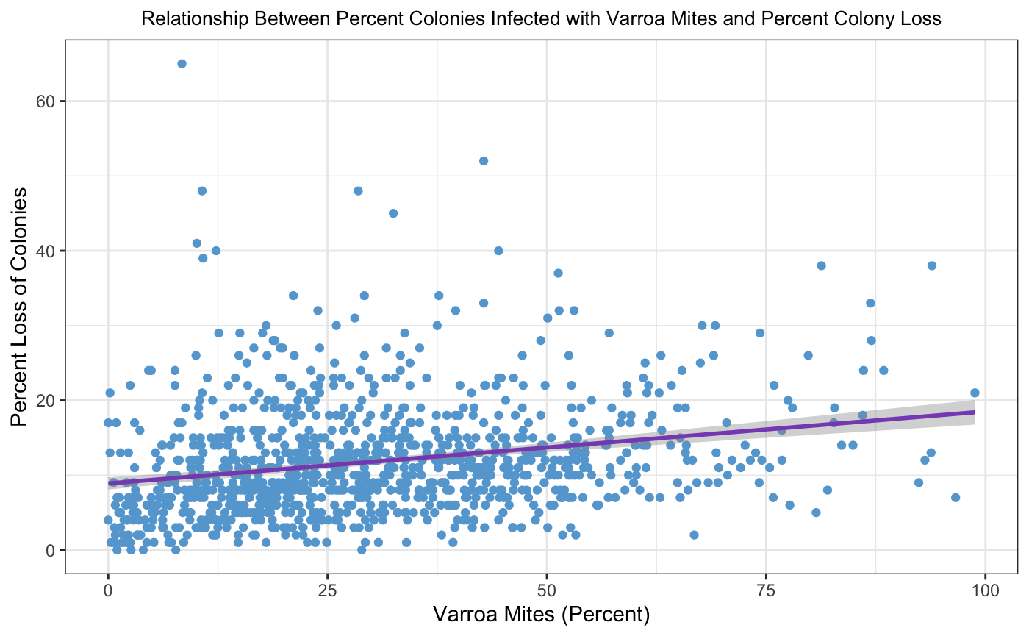
Varroa Mites and Percent Colony Loss
Percentage Varroa Mite infection is significant, indicating changes in colony loss are correlated with changes in infection rate

Slide 23
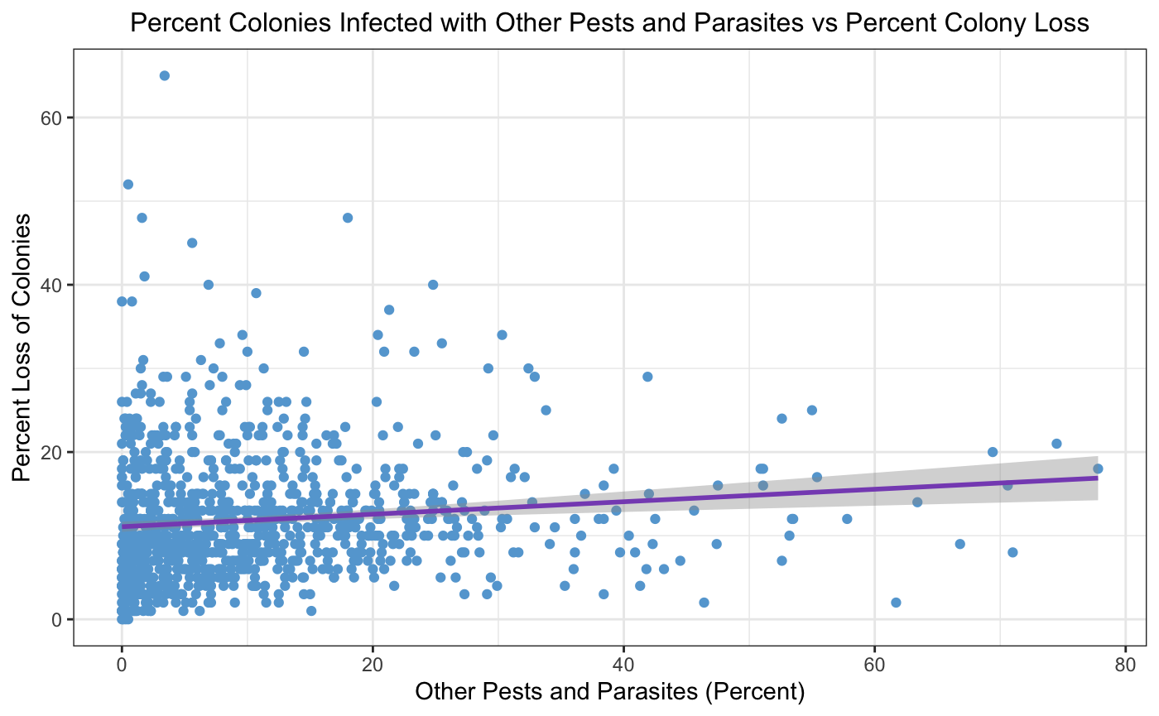
Other Pests & Parasites and Percent Colony Loss
A significant variable, indicating changes in colony loss are correlated with changes in infection rate
Alone it is not explaining much of the variation in Colony Loss

Slide 24
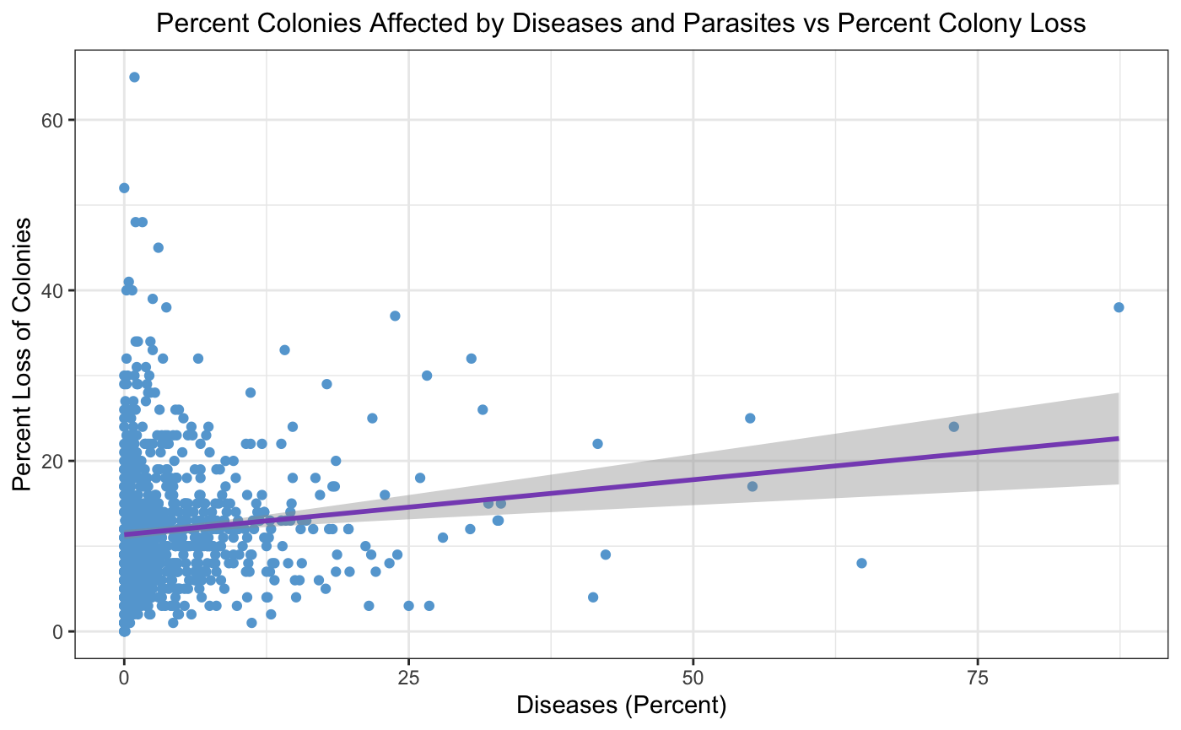
Diseases and Percent Colony Loss
A significant variable, indicating changes in colony loss are correlated with changes in infection rate
Alone it is not explaining much of the variation in Colony Loss

Slide 25
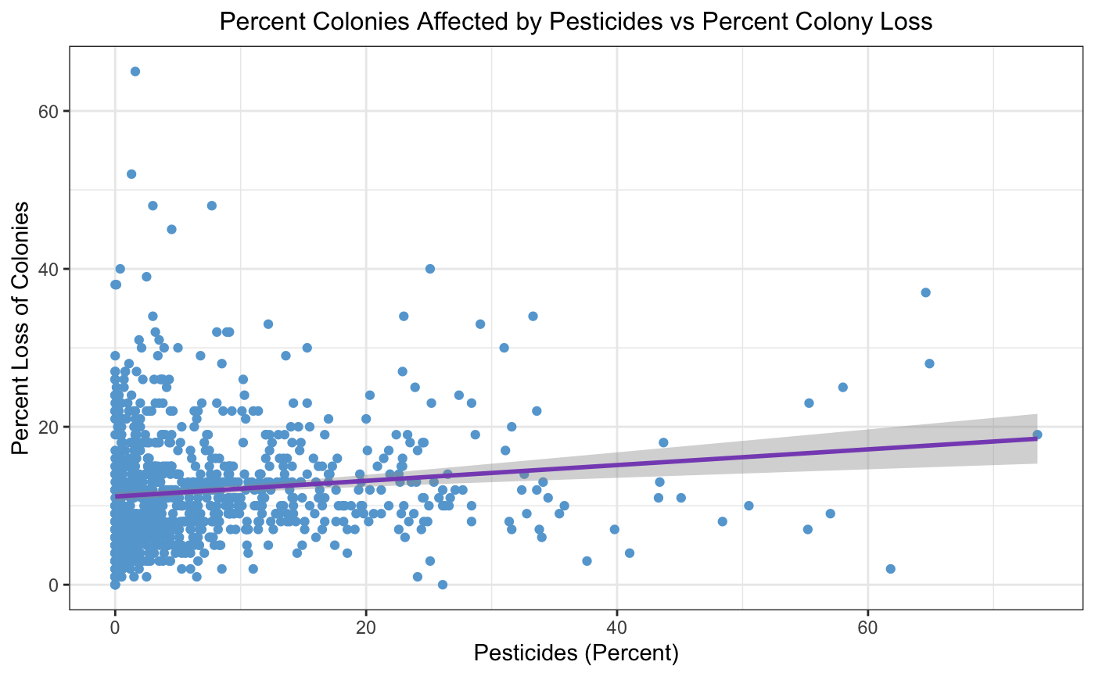
Pesticides and Percent Colony Loss
A significant variable, indicating changes in colony loss are correlated with changes in infection rate
Alone it is not explaining much of the variation in Colony Loss

Slide 26
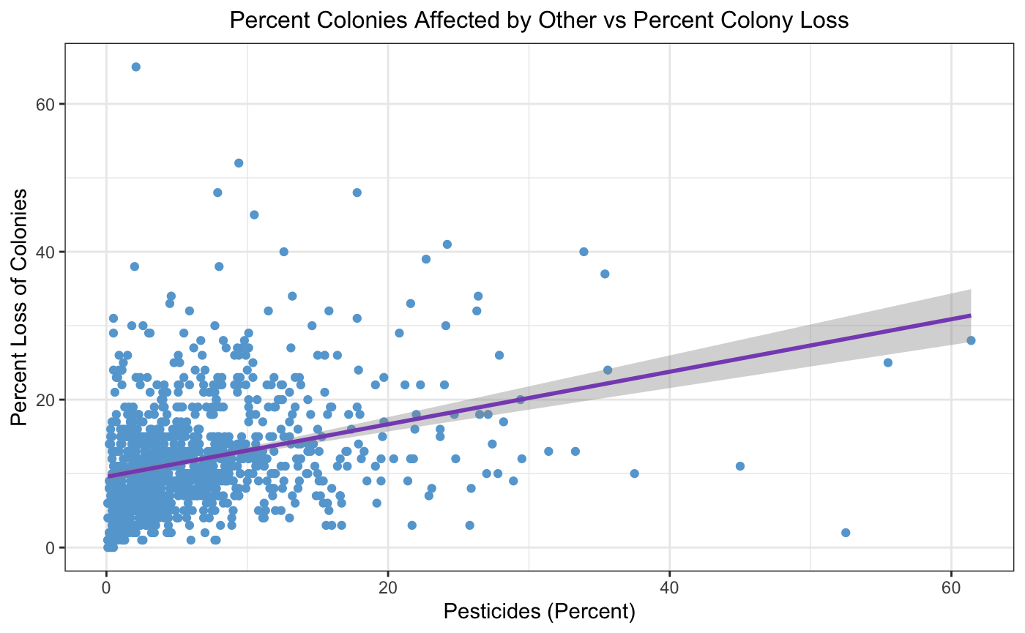
Other Stressors and Percent Colony Loss
A significant variable, indicating changes in colony loss are correlated with changes in infection rate
Alone it is not explaining much of the variation in Colony Loss

Slide 27

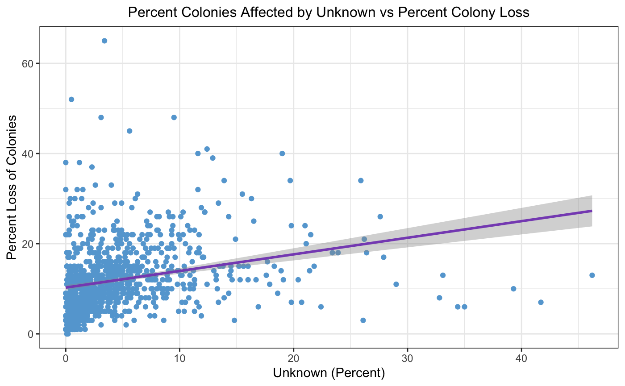
Unknown Stressors and Percent Colony Loss
A significant variable, indicating changes in colony loss are correlated with changes in infection rate
Alone it is not explaining much of the variation in Colony Loss

Slide 28
Summary
Bee populations have stabilized in recent years
Most colony loss occurs during colder winter months
Colony loss depends on a variety of factors including geographic location
Most observed colony loss in the U.S. occurs in the Mid-West and Mid-Atlantic Regions
There are a myriad of many complex factors and interactions at play that contribute to colony loss including Varroa Mite parasites (most prominent), diseases, pesticides and more
More extensive research needs to be done to pinpoint a cause for CCD

Slide 29
Next Steps…
Including additional metrics/parameters (i.e. habitat loss)
More longitudinal time data
More granular temperature data (i.e. monthly, humidity)
Building a multivariate model to describe colony loss
Making predictions!

Slide 30
Data Sources
Don’t worry, bee happy
Bee Colony Data: https://www.kaggle.com/datasets/kyleahmurphy/nass-honey-bee-20152021
Temperature Data: https://www.ncdc.noaa.gov/cag/statewide/time-series/50/tavg/12/4/2015-2022?base_prd=true&begbaseyear=1901&endbaseyear=2000&fbclid=IwAR0agv7-tZQdluJpUc8ErGi8QVyq2BC0VAtW25E6oVks0vIRMp8GjgPVNYY

